Slide 1
PIZZA SALES ANALYSIS
Using MS SQL and MS POWER BI

Slide 2
Project Summary
AIM: To analyze and find the trends in the pizza sales in the year 2015 using MS SQL and MS Power BI.
APPROACH: First, indicate the KPIs which determine the project aim and then import the data in SQL Server and further find the required KPIs .After this import the data from SQL Server to MS Power BI and then clean the data if necessary , following which create suitable Measures using DAX formulas and design a dashboard to visually represent the trends.
KPIs:
1) Total Revenue: The total revenue generated by the sales of pizzas.
2) Total Quantity: The total quantity of pizzas sold in 2015.
3) Total Orders: The total orders received by the pizza company.
4) Average Pizzas Per Order: The average pizzas sold in a single order.
5) Average Order Value: The average value of money per order.
6) Percentage Of Sales by Size and Category: Total revenue generated by particular size and pizza category.
7) Total Pizzas sold by Category: This is the total number of pizzas sold by category.
Other Trends:
-> Daily Pizza Sales Trend and Monthly Pizza Sales Trend
-> Top 5 pizzas by Revenue.
-> Top 5 pizzas by Quantity.
-> Top 5 pizzas by Orders
-> Top 5 pizzas sold by Size

Slide 3
Data Analysis Using MS SQL
create database SQL_PROJECTS;
use SQL_PROJECTS;
select * from pizza_sales;
-- Total Revenue
select sum(total_price) as Total_Revenue from pizza_sales;
-- Average Order Value
select sum(total_price)/count(distinct order_id) as Average_Order_Value
from pizza_sales;
--Total Pizzas Sold
select sum(quantity) as Total_Pizzas_Sold
from pizza_sales;
--Total Orders
select count(distinct order_id) as Total_Orders
from pizza_sales;

Slide 4
--Average pizzas per order
select cast(cast(sum(quantity) as decimal(10,2))/cast(count(distinct order_id) as decimal(10,2)) as decimal(10,2))
as Average_Pizzas_Per_Order from pizza_sales;
--Daily Sales
select datename(DW,order_date) as order_day,count(distinct order_id) as no_of_orders
from pizza_sales
group by datename(DW,order_date)
--Monthly sales
select datename(Month,order_date) as order_month,count(distinct order_id) as no_of_orders
from pizza_sales
group by datename(Month,order_date);
--Percentage of sales by pizza category
select pizza_category,cast(sum(total_price) as decimal(10,2)) as total_revenue,
cast(sum(total_price)*100/(select sum(total_price) from pizza_sales) as decimal(10,2)) as sales_percent_by_pizza_category
from pizza_sales
group by pizza_category
order by sales_percent_by_pizza_category

Slide 5
--Percentage of sales by Pizza size
select pizza_size,cast(sum(total_price) as decimal(10,2)) as total_revenue,
cast(sum(total_price)*100/(select sum(total_price) from pizza_sales) as decimal(10,2)) as sales_percent_by_size
from pizza_sales
group by pizza_size
order by sales_percent_by_size
--Total Pizzas sold by category
select pizza_category,sum(quantity) as total_pizzas_sold
from pizza_sales
group by pizza_category
order by total_pizzas_sold
--Top 5 pizzas by revenue
select top 5 pizza_name as pizzas,sum(total_price) as total_revenue
from pizza_sales
group by pizza_name
order by total_revenue desc
--Bottom 5 pizzas by revenue
select top 5 pizza_name as pizzas,sum(total_price) as total_revenue
from pizza_sales
group by pizza_name
order by total_revenue asc

Slide 6
--Top 5 pizzas by quantity
select top 5 pizza_name as pizzas,sum(quantity) as quantity_sold
from pizza_sales
group by pizza_name
order by quantity_sold desc
--Bottom 5 pizzas by quantity
select top 5 pizza_name as pizzas,sum(quantity) as quantity_sold
from pizza_sales
group by pizza_name
order by quantity_sold asc
--Top 5 pizzas by pizza size
select top 5 pizza_name as pizzas,sum(quantity) as quantity_sold
from pizza_sales
where pizza_size = 'L'
group by pizza_name
order by quantity_sold desc
-- Top 5 pizzas by orders
select top 5 pizza_name as pizzas , count(distinct order_id) as total_orders
from pizza_sales
group by pizza_name
order by total_orders desc

Slide 7
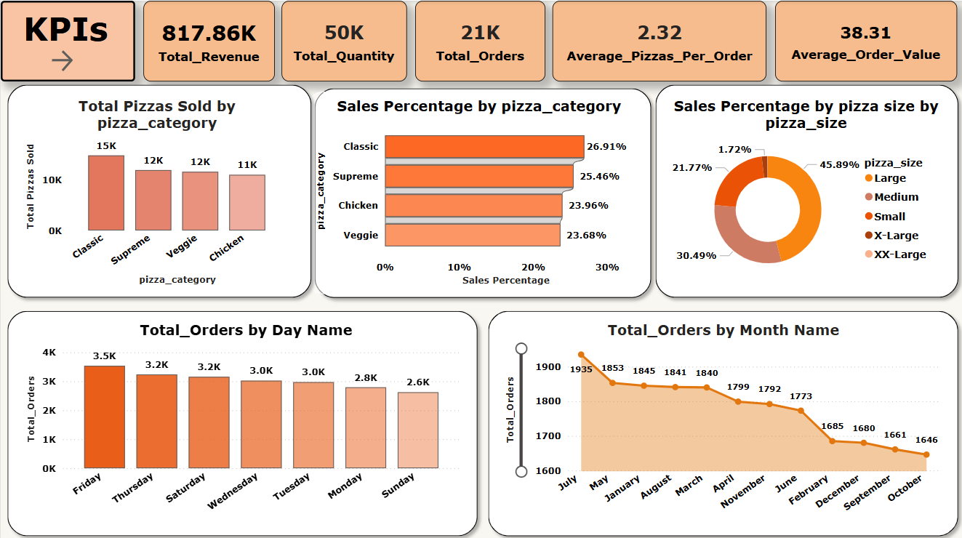
Data Analysis Using Power BI

Slide 8
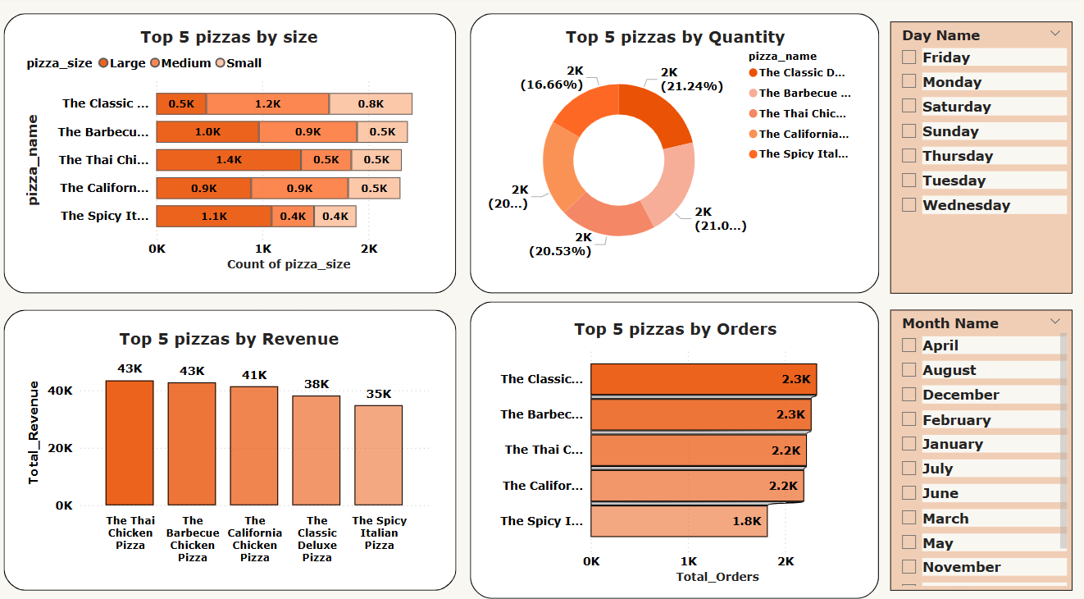

Slide 9
